Slide 1
Maximizing the lifetime of a network
EE550 - Michelle Beryl, Bill (Belal) Wang

Slide 2
Motivation
“Recently wireless sensor network (WSN) has been widely used for monitoring railway tracks and rail tunnels. The key requirement in the design of such WSN is to minimize the energy consumption so as to maximize the network lifetime. ”^{[1]}
Network Lifetime is an important metric in analyzing wireless sensor networks with varying node energies/costs
Goal is to maximize the network lifetime, which allows for the maximum amount of data to be sent
Notes:
[1] https://www.sciencedirect.com/science/article/pii/S2215098615001743

Slide 3
Original Problem
Originally, we brainstormed a few problems incorporating node lifetimes, such as:
Opportunistic routing and calculation of expected travel time from source to destination
Shortest path as a priority metric for opportunistic routing; lifetime as a shortest path tiebreaker
Calculating ratio of successful packets received VS total packets sent given possible node failures
After initial brainstorming and problem development, we decided to focus on the topic of maximizing network lifetime

Slide 4
Problem Setup

Slide 5
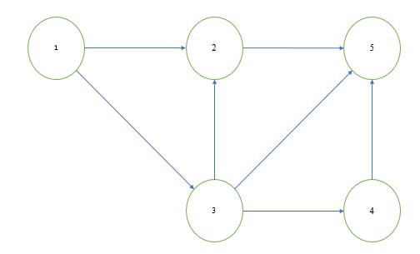
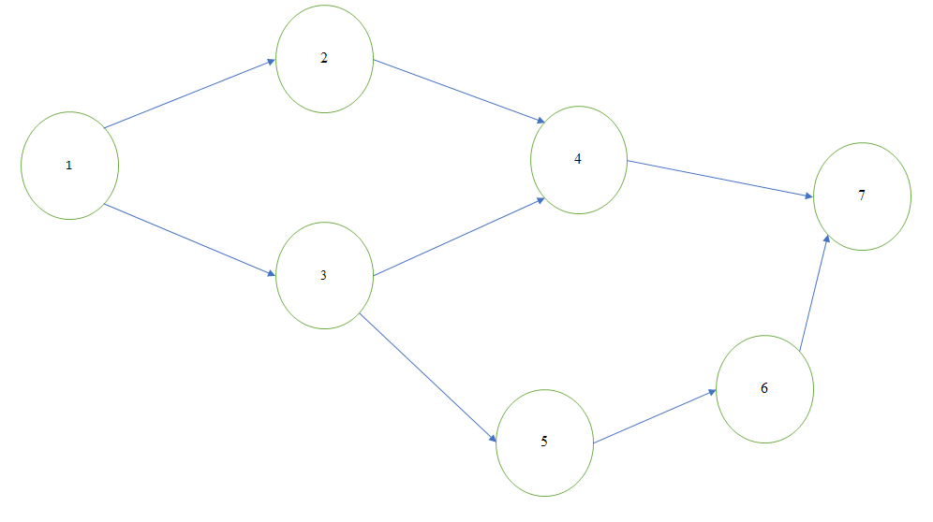
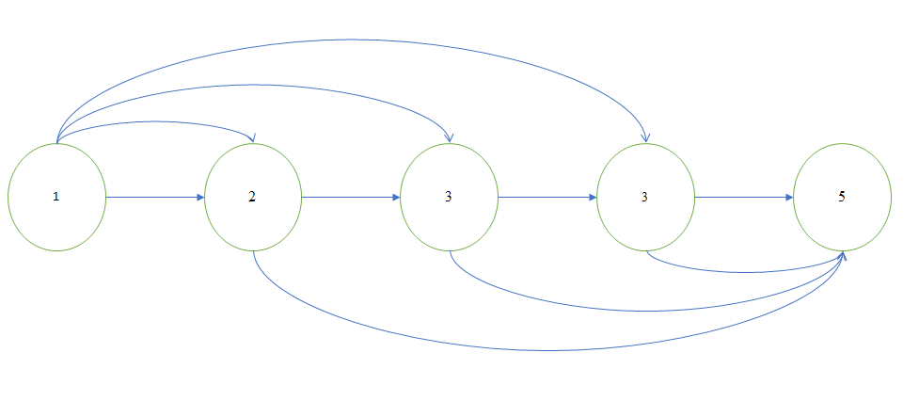
Problem Statement
Find the maximum number of packets that can be sent on a given network from a source node (1) to a destination node (5), such that:
Packets are sent one by one along some path Pi
Each node n has some lifetime Ln and some energy cost En
Lifetime decreases by En every time the node is used
When a node reaches a lifetime <0, that node is removed from the network, and all paths that use the node are invalid

Slide 6
Assumptions
In the context of this presentation, we make a few assumptions:
Node Lifetimes are set to L=5
Source and Destination nodes have infinite lifetimes
Energy Costs per packet are set to 1
Thus, each node can be used a total of Ln/En =5 times before being removed from the network
Figure 1: Problem Network

Slide 7
Problem Solving Approaches
Intuition/Small Network, Brute Force
Integer Program as Linear Program with rounding
Shortest Paths first
‘Pruning’ Approach
Computer Program/MATLAB

Slide 8
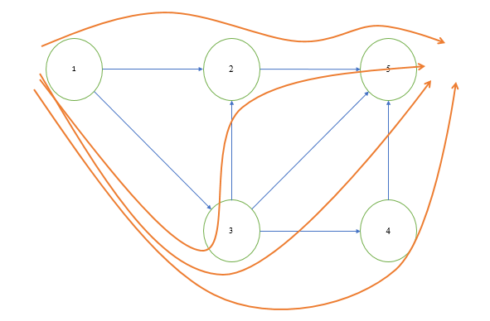
Intuition
For a small network, we can intuitively determine the best paths to use for extending the net network’s lifetime with a couple ideas:
Paths with fewest nodes will consume the least amount of net available lifetime
Paths over shared nodes/intersections should be minimized; if possible, disjoint paths should be used
Consider shortest paths and ‘pruning’
Figure 2: Network with paths from nodes 1->5

Slide 9
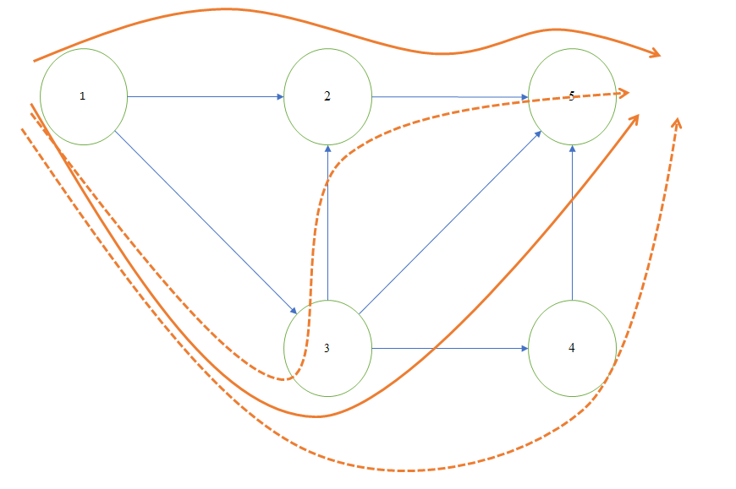
Shortest Path, ‘Pruning’
One strategy explored was using shortest paths and ‘pruning’:
First identify the shortest paths (Figure 3). For simple networks, it may be possible to use only shortest paths to maximize lifetime, with the intuition that shortest paths use the smallest number of nodes
The next idea was to ‘prune’ paths that are supersets of other paths. For example, in this network we find that Path 1325 and 1345 are supersets of Path 135. Thus those paths will never be in the ‘optimal’ paths used to achieve maximal lifetime.
Figure 3: ‘Pruned’ paths with viable paths in solid arrows
Notes:
Note that 1345 could still be used with 125 to achieve maximum lifetime in some cases (eg all lifetimes same). However, will never be using 135 outright, as L4 could be a limiting factor

Slide 10
Intuition (Continued)
For this network, there are four possible paths: P1={1 2 5}; P2={1 3 5}; P3={1 3 2 5} ; P4={1 3 4 5}
Because P4 is a superset of P2, it could be removed from the set of paths, leaving P1={1 2 5}; P2={1 3 5}; P3={1 3 2 5}
P3 could not be removed as it is also a superset of P1. Thus the solution is a combination of P1 and P2 and P3.
With node lifetimes of 5, we can see that the maximal lifetime is achieved when P1 is used 5 times and P2 is used 5 times, in any order. P3 would not be used as we can see that it would reduce lifetime of P1 as well.
Figure 3: ‘Pruned’ paths with viable paths in solid arrows

Slide 11



Integer Program
Maximize:
Such That:
Where:
Ji is the # of packets sent on each path i, en is the energy cost of each node n, set to 1 for our project Ln is the lifetime of each node n P is the set of all paths All values are positive
Figure 2: Network with paths from nodes 1->5

Slide 12
Integer Program (Solution)
For the example network, we have the following equations:
Maximize: J1+J2+J3+J4 Such that: J1+J3 ≤ 5 (L2) J2+J3+J4 ≤ 5 (L3) J4 ≤ 5 (L4)
Solving for the values of J (number of packets sent on each path), we find there are a few solutions, same results as intuition:
Solution={{5J1+5J2}, {5J1+5J4}, {5J1+5(J2 or J4)}}=10 packets total
Figure 2: Network with paths from nodes 1->5

Slide 13
Integer Program (Solution)
We could also approximate the integer program as a Linear Program:
f=[-1 -1 -1] A=[1 0 0 0 0 1 1 1 0 0 0 1] b=[5 5 5]
Results of this program could be rounded to provide near optimal, if not optimal solution. In this case there are multiple solutions and we need to impose additional constraints for the integer program to work in MATLAB.
Figure 2: Network with paths from nodes 1->5

Slide 14
Counterexample

Slide 15
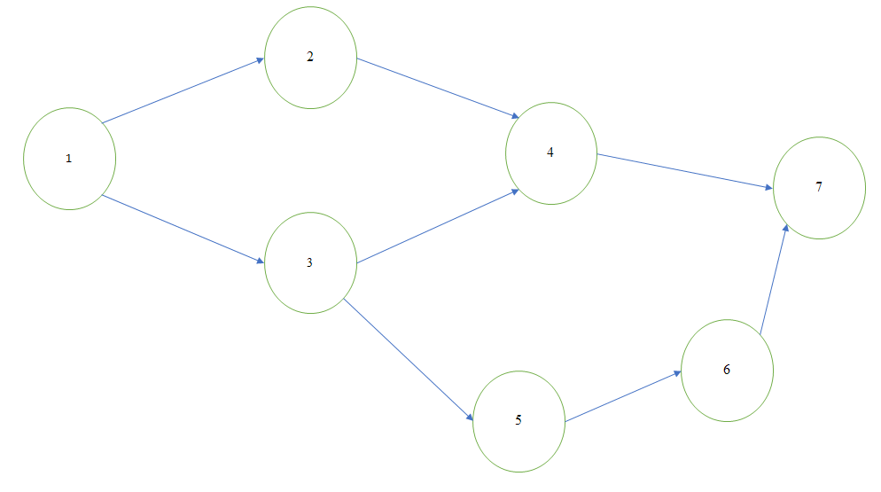
Counterexample
While the previous methods discussed work for a small, simple network, they may not be applicable to all networks. Specifically the Shortest Path can not be applied to networks with intersections between paths.
Figure 4: Counterexample Network

Slide 16
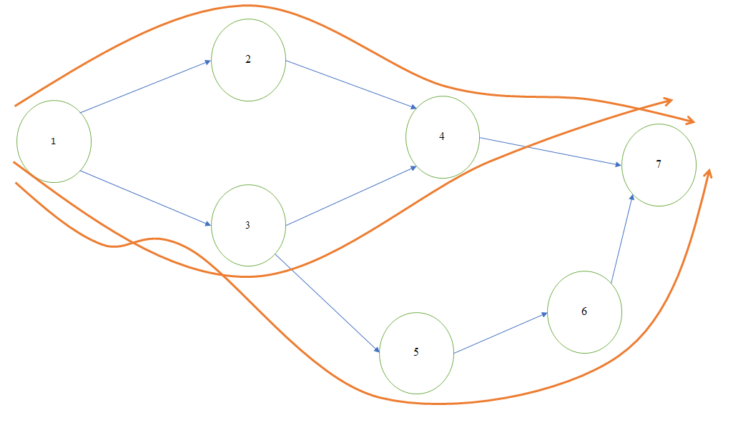
Counterexample
This network has 3 paths available: P1={1 2 4 7}; P2={1 3 4 7}; P3={1 3 5 6 7}
Both P1 and P2 can be ‘shortest path’ using ‘# of hops’ or ‘total lifetime drained’ priorities.
However, using P2 first will not result in an optimal solution, as it uses both nodes 2 and 3 which are required for P1 and P3
Figure 5: Counterexample with Paths from node 1->7

Slide 17
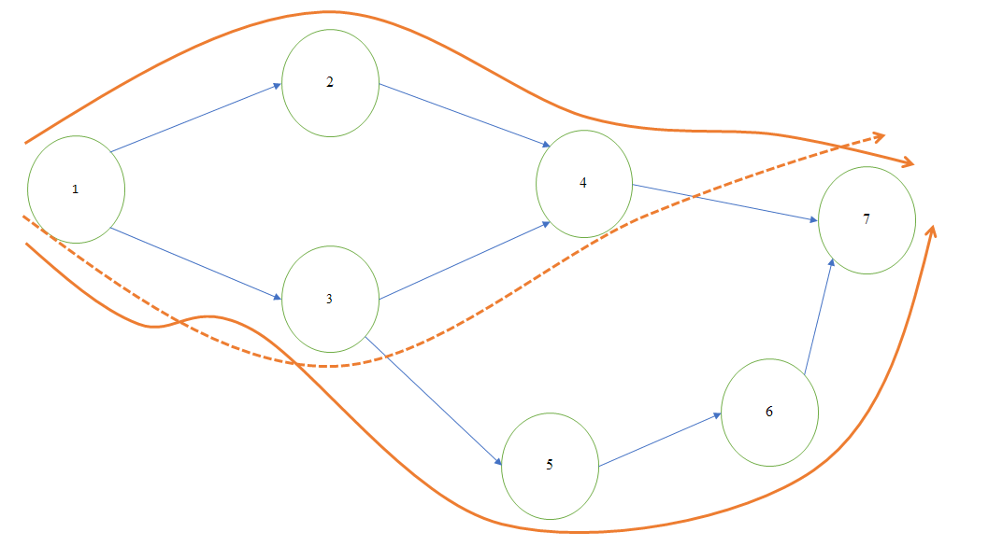
Counterexample
This network has 3 paths available: P1={1 2 4 7}; P2={1 3 4 7}; P3={1 3 5 6 7}
Both P1 and P2 can be ‘shortest path’ using ‘# of hops’ or ‘total lifetime drained’ priorities.
However, using P2 first will not result in an optimal solution, as it uses both nodes 2 and 3 which are required for P1 and P3
An optimal solution uses only P1 and P3, as these are disjoint, and a maximum of 10 packets can be sent using 5 P1s and 5 P3s
Figure 6: Counterexample Network with viable paths in solid arrows

Slide 18
Counterexample Integer Program
We can solve the counterexample using an Integer Program as well, using the following equations:
Maximize: J1+J2+J3 Such that: J1 ≤ 5 (L2) J2+J3 ≤ 5 (L3) J1+J2 ≤ 5 (L4) J3 ≤ 5 (L5) J3 ≤ 5 (L6)
Solving for the values of J (number of packets sent on each path), we find there is only one solution, same results as intuition: Solution={{5J1+5J3}=10 packets total
Figure 5: Counterexample with Paths from node 1->7

Slide 19
MATLAB Section

Slide 20
Using Code to Analyze
As network complexity increases, it may be necessary to simulate to find optimal solutions. We can use MATLAB to assist, and also to verify results.
After a large enough number of simulations, the code provides:
Minimum and maximum number of packets sent on the network
Paths selected to achieve those values
This allows for further verification of results and confirmation on accuracy of various approaches. In addition, the code provides the minimum and maximum ‘lifetime’ for any arbitrary network even with altered lifetimes or energy costs. Given a larger graph (with larger # paths), it would take longer simulation time to provide more accurate simulations.

Slide 21
Strategy for Coding
Brute Force/Permutation
Extension of the Integer Program
O(n!) or O(c^n) exponential complexity order
Shortest Path
Fairly simple
Not necessarily the correct solution depending on network layout
Random selection of paths ★
Good approximation of minimal and maximal solutions given enough trials
Able to simulate in MATLAB

Slide 22
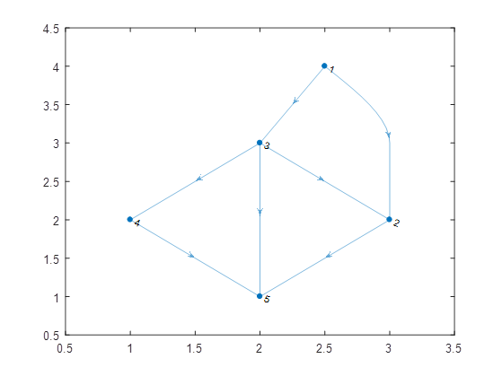
Code Results
For the original network, the Matlab code produces the following after 200 runs:
minP: 5 packets maxP: 10 packets Pathsmin: {P3 P3 P3 P3 P3} pathsmax: {P4 P1 P1 P4 P1 P1 P1 P4 P2 P2}
This supports the analytical results that maximum network lifetime is 10 packets, using Paths 1, 2, and 4

Slide 23
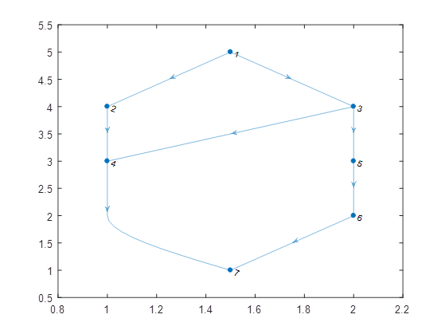
Code Results (Counterexample)
For the counterexample network, the Matlab code produces the following after 200 runs:
minP: 5 packets maxP: 10 packets Pathsmin: {P2 P2 P2 P2 P2} pathsmax: {P1 P3 P3 P1 P3 P3 P1 P1 P3 P1}
This supports the analytical results that maximum network lifetime is 10 packets, using Paths 1 and 3 only

Slide 24
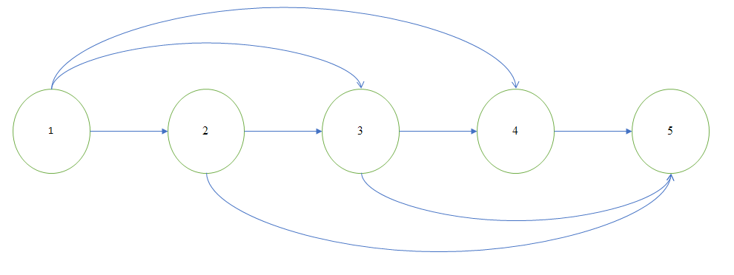
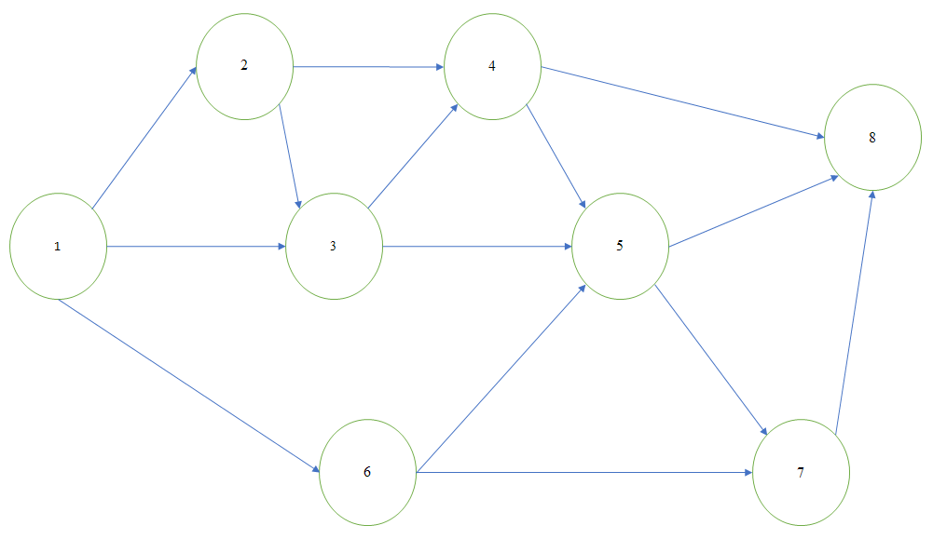
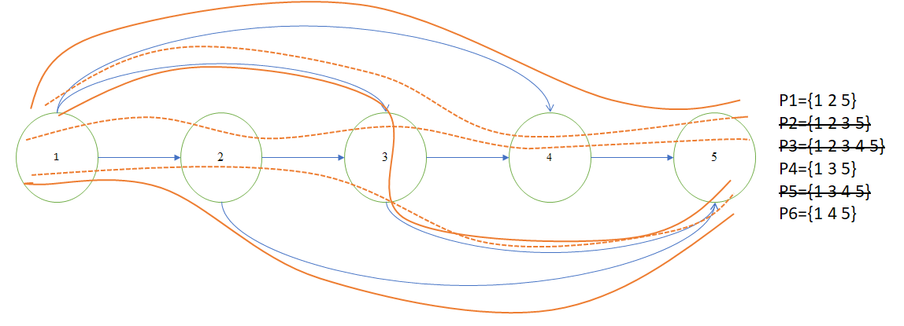
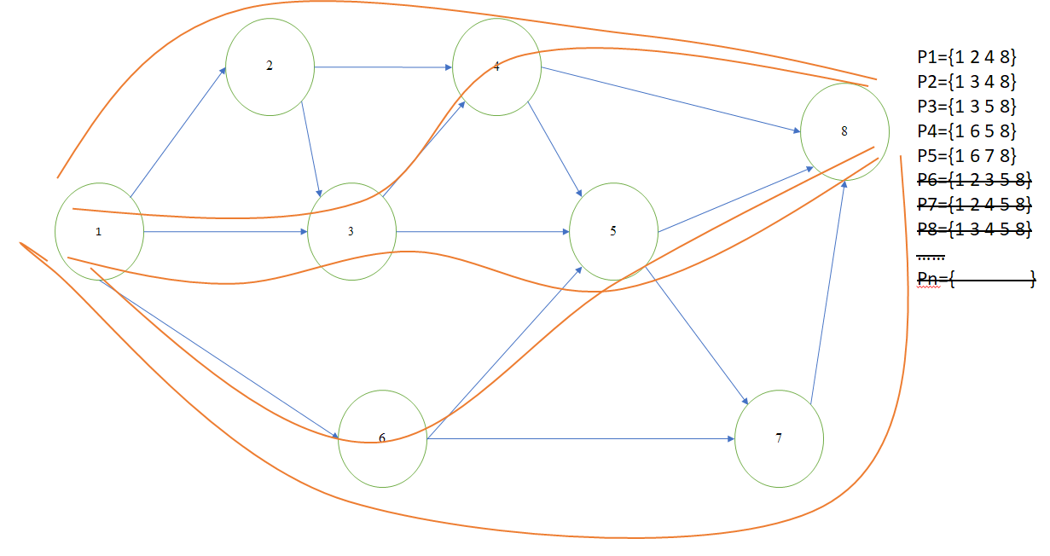
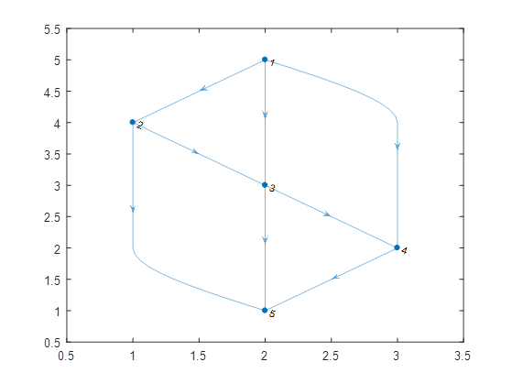
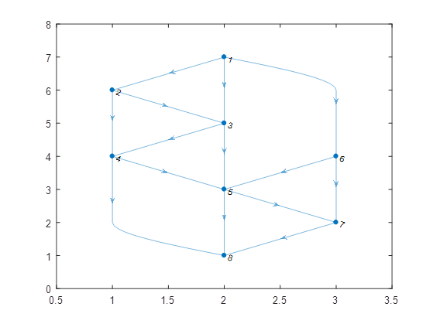
Sample Arbitrary Networks
minP=6
maxP=14
pathsmax={P6 P1 P4 P1 P1 P6 P4 P4 P1 P5 P4 P6 P1 P6}
minP=5
maxP=13
pathsmax={P3 P1 P3 P5 Pn P4 Pn Pn P1 P5 P5 P5 P1}

Slide 25
Conclusions

Slide 26
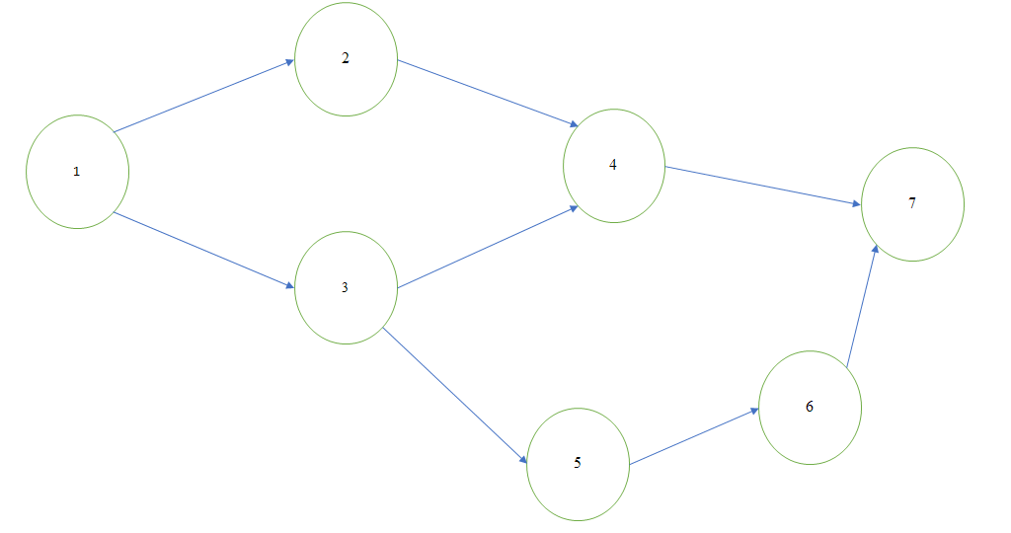
Conclusions
There are a couple ways to approach the problem of maximizing network lifetimes
Intuition, finding shortest paths, paths containing disjoint nodes, ‘pruning’
Integer Program
MATLAB Program
There may be more than one ‘optimal’ solution, but the optimal solutions should contain the same number of each path
Further tiebreakers could be implemented in both analytical and code solutions, to specify the problem further and reduce the number of optimal solutions

Slide 27
Future Considerations
If we had more time, we could vary the lifetimes of the nodes in the network and maximize the number of packets sent before the network lifetime expires.
We could also try varying the energy consumption values for each node, to see how the number of packets and network lifetime can be maximized when a different amount of energy is consumed as the packet passes through each node.
We could try different metrics in our shortest path calculation (number of adjacent nodes, number of intersecting nodes, tiebreakers), that might help develop a more general analytical solution. Define ‘optimal’ further, so that the Integer Program does not allow multiple solutions
Instead of randomly selecting paths, ordering them in various combinations. Answer the question: ‘does order of path selection matter when maximizing lifetime?’

Slide 28
References
[1] Philipose, A., & A, Rajesh. (2016). “Investigation on energy efficient sensor node placement in railway systems”. Engineering Science and Technology, an International Journal.
Found online : https://www.sciencedirect.com/science/article/pii/S2215098615001743
[2] “pathbetweennodes.m”, github.com/kakearney; MATLAB code to enumerate all paths given a digraph

